Slide 1
Car data analysis
Name: ASHER C ALEXANDER
Mentor Name: Jaya Pandey

Slide 2
Introduction:
Project -1:
The data is analyzed to identify the top car manufacturer and the car with the best features, based on the provided information.
Project -2:-
We conducted a statistical analysis of the data, examining dispersion, variation, coefficients, and correlations. This analysis provided insights to determine which car manufacturer offers the widest range of car models and variations.

Slide 3
Objective:
Prepare the car dataset for analysis.
Determine critical factors influencing new car model launches.
Evaluate manufacturers and assess competitive diversity in the market.
Examine fuel efficiency trends to identify opportunities for emission reduction.
Highlight the most diverse car manufacturer in the country.
Deliver actionable insights to guide product development and innovation.
Present findings on potential car models and strategies for improving fuel efficiency.

Slide 4
Business Requirement
Top 10 Cars with highest mileage
Top 10 cars based on Displacement
"Mahindra E20 Plus has the maximum mileage.“
BMW manufacturer has the highest displacement

Slide 5
Top 3 Manufacturer with hatchback body type
Top 3 are Suzuki , Hyundai and Mahindra

Slide 6
To find the relationship between values.
From the data we can analyze that there is a negative relationship between the values in both cases.

Slide 7
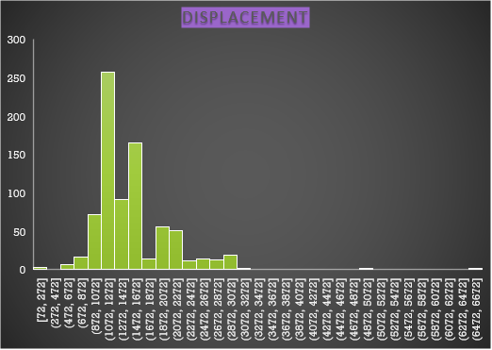
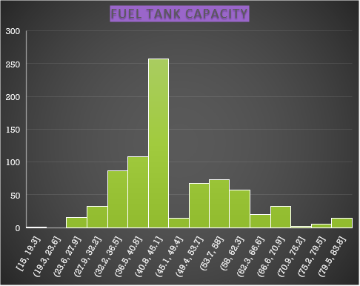
To find the outliers using histogram
From this graph we can see the frequency and with its displacement and fuel tank capacity.

Slide 8
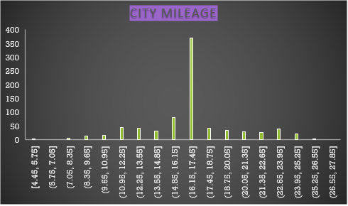
Business Requirement
To find the outliers for City mileage with Histogram
Top 10 car with hatchback
We can see the range and its corresponding frequencies.
To know how many car manufacturer have hatchback body-type.

Slide 9
To find the Top car manufacturer based on the body-type.
In this we can find a variety of car manufacturer with their body type and top car manufacturer are visible.

Slide 10
To find the most car with the particular body-type.
We have found the top body-type and the Top-3 are:-
1.)Hatchback
2.)SUV
3.)Sedan.

Slide 11
To find the no. of CAR VARIANTS in each car manufacturer

Slide 12
TOP 2 MANUFACTUREING CAR'S NO OF VARIATION WITH BODY TYPE

Slide 13
To find the correlation between the data’s.
From this data we can find that the scatter plot has a negative trend line and the correlation between them is negative
From this data we can find that the scatter plot has a positive trend line and the correlation between them is positive

Slide 14
To find the AVERAGE fuel efficiency

Slide 15
To find the AVERAGE fuel efficiency
In the three charts we have found out that which has The highest maximum average fuel efficiency and in each car manufacturer and their models and also based on their Fuel or Engine type.

Slide 16
To find correlation between values
Count of fuel efficiency and body type
DISTANCE and Avg.Combined Mileage
The data is plotted on bar chart to find the highest value
From this we can understand that the data has a ppositive trend line

Slide 17
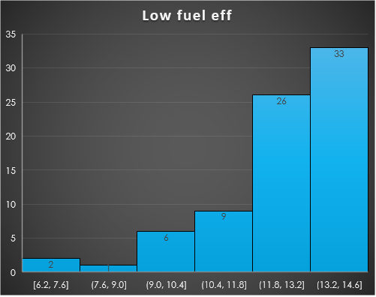
Fuel Efficiency

Slide 18
Fuel Efficiency
The charts presented in the previous slide and this slide illustrate how the data was analyzed and subsequently represented using a histogram. These charts depict the levels of fuel efficiency—categorized as low, moderate, and high—derived from the data using a pivot table. The pivot table played a crucial role in organizing and segregating the data, enabling it to be visualized in a clear and comprehensible manner for the audience.

Slide 19
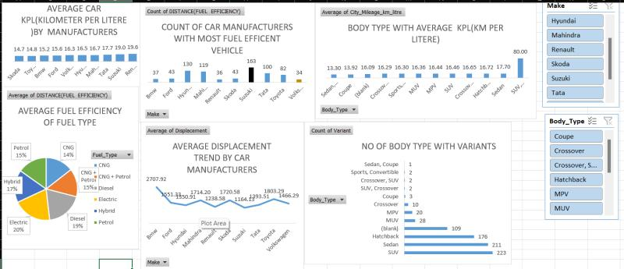
DASHBOARD

Slide 20
Summary
Top Performers:
Mahindra E20 Plus: Highest mileage.
BMW: Highest engine displacement.
Top Body Types: Hatchback, SUV, Sedan.
Leading Hatchback Manufacturers: Suzuki, Hyundai, Mahindra.
Car Variants: Diverse offerings identified across manufacturers.
Fuel Efficiency: Categorized into low, moderate, and high through statistical analysis.

Slide 21


